Slide 1
From Reactors to Revenue
Oklo's Path to Profitability

Slide 2
80+
startups need regulatory help
● 80+ Startups
● Target Clients
New nuclear startups need help
~$4B+
in total funding

Slide 3
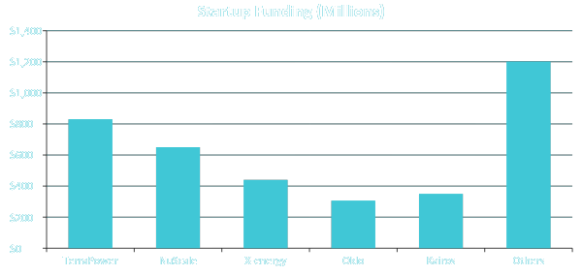
OKLO
The Crowded Market

Slide 4
OKLO
What They All Need
10+
$50M+
Zero
Years of Licensing
In Regulatory Costs
Reactor Experience

Slide 5
✓ NRC Requirements Mastered
✓ Regulatory Process Mapped
✓ Common Mistakes Identified
✓ Winning Strategy Developed
Oklo has already done this.
2020
First NRC Application
2025
$140M Expertise
→
First NRC Application
NRC Rejection → Learning
$140M Knowledge Asset

Slide 6
Three Revenue Streams
OKLO
Licensing
Safety
Fuel Cycle
$75M
$42M
$23M
2030 Annual Revenue Targets

Slide 7
OKLO
Market Opportunity
$6.2B
Global
$1.9B
U.S. Market
$570M
Our Target

Slide 8
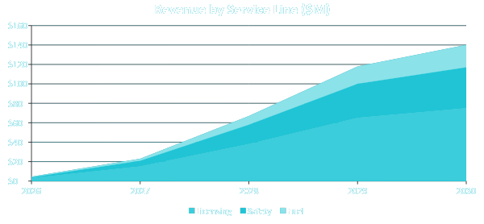
OKLO
5-Year Growth

Slide 9
OKLO
EBITDA by 2030
$42M
35-40% margin

Slide 10
OKLO
4-Year Roadmap
2026
2027
2028
2030
Launch
Scale
Expand
Lead
3 clients
20 clients
40 clients
100+ clients

Slide 11
OKLO
The Investment
$2M
↓
$140M by 2030
70x return in 4 years

Slide 12
OKLO
Turn Expertise into Revenue
Questions?

